Slide 1

Operations Research Course Report
Optimization of a Crude Oil Transportation: From LP to MILP
Xiaoyu Gu, Yiming Zhou, Yunyixuan Zhang
January 5, 2025

Slide 2



Outline
Review of the Original LP Problem
Formulation of the Extended MILP Problem
Analysis and Solution to the MILP Problem
Limitations and Outlook

Slide 3
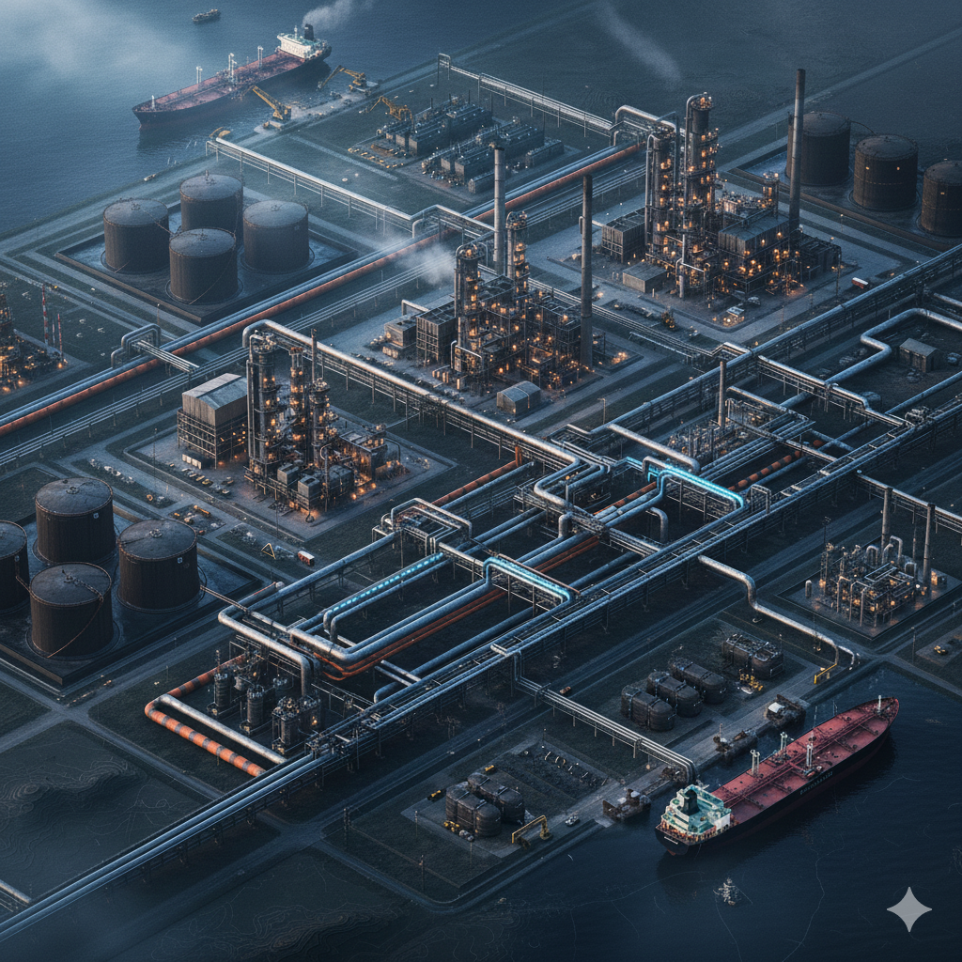
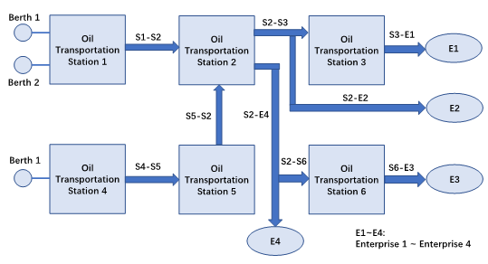
Review
The original problem is a linear programming problem that aims to find a solution minimizing transportation costs within a given oil pipeline network diagram and constraints on the transportation volumes of various oil products.
To address this issue, we first utilized the demand for each fuel type at each site. By introducing the Floyd-Warshall algorithm to solve the shortest path pair problem between sites, we simplified and modeled the problem (converting it into a standard linear programming problem). Subsequently, we employed the linprog function in MATLAB to solve the original problem, thereby obtaining the optimal solution for this transportation.

Slide 4
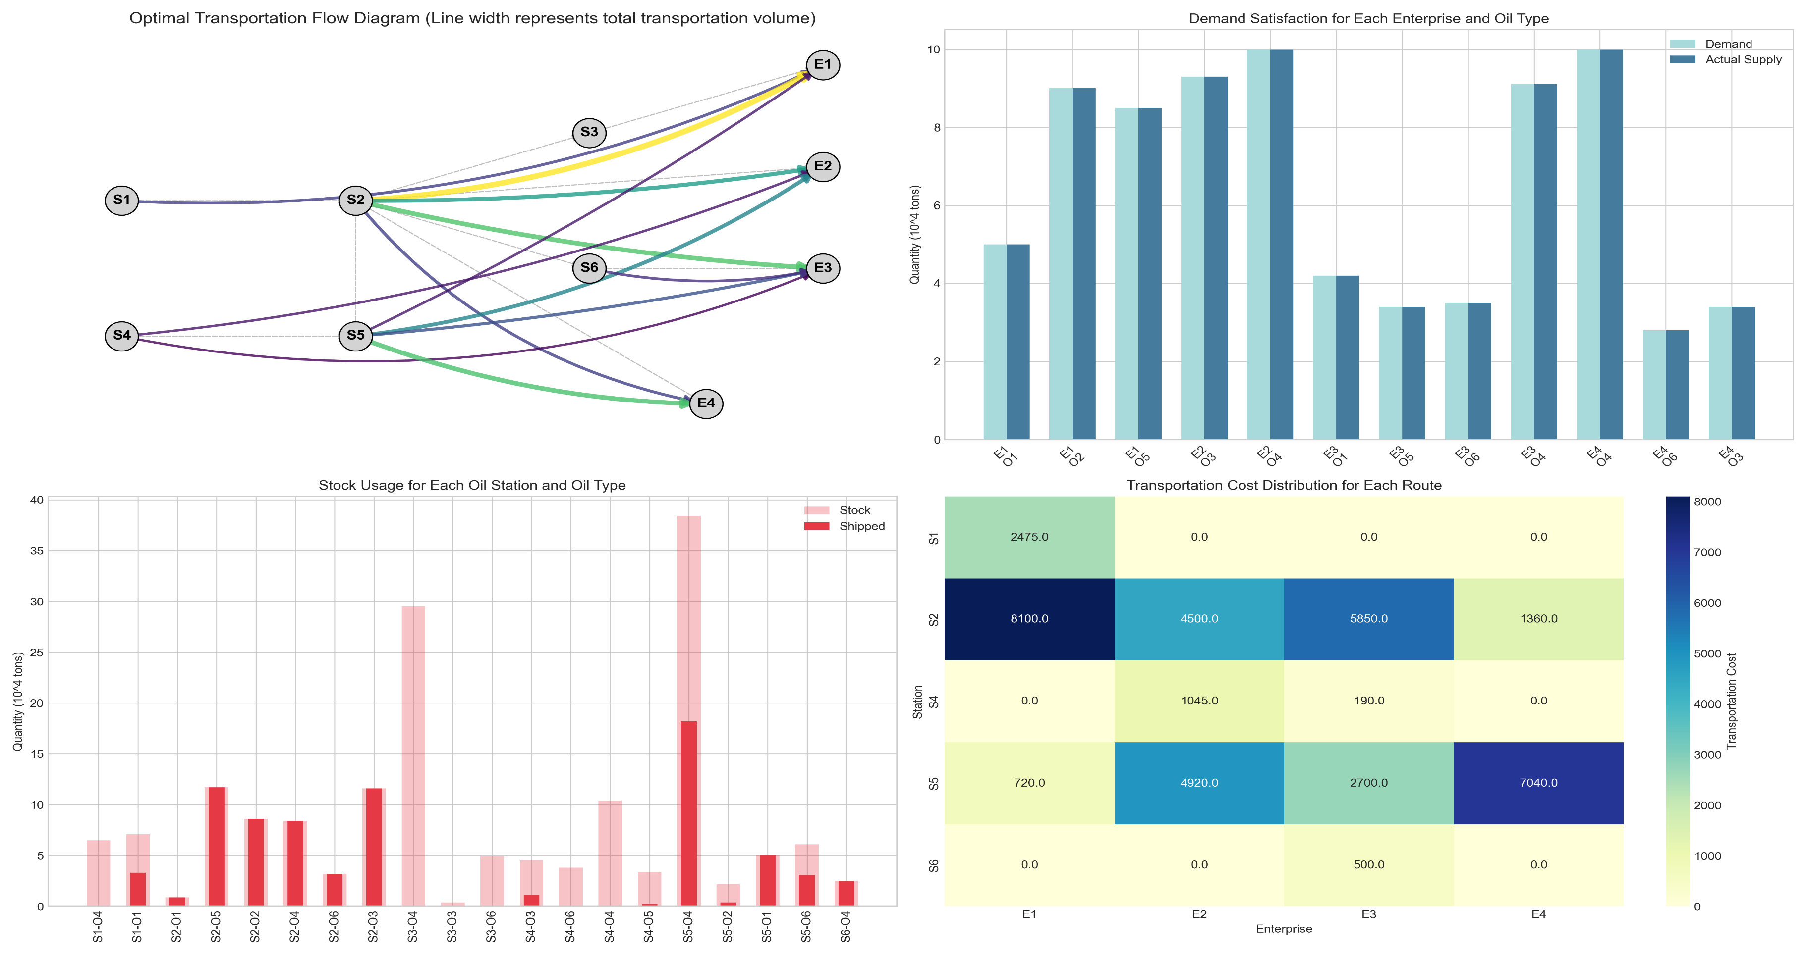
Solution to the Original Problem

Slide 5
Formulation of the Extended MILP Problem
The new problem focuses on the 24-hour cyclic scheduling optimization of a complex crude oil pipeline network. The system must coordinate the transportation of 6 different types of crude oil from maritime terminals through a storage station network to meet the time-varying hourly demands of downstream enterprises.
Network Structure
Pipeline Limitations
D-S Demand
The network infrastructure consists of three types of nodes: 6 storage stations (S1-S6), 4 production enterprises (E1-E4), and virtual terminals. Key logistical constraints include specific unloading capabilities at stations S1 and S4, while S2 serves as a critical central hub connecting multiple directions with physical flow restrictions.
The system operates through 11 major pipelines, each governed by specific capacity limits and geographical distances. A primary challenge is the "valve mutual exclusion" at hub S2, where physical manifold structures prevent simultaneous flows toward certain storage stations and enterprises in the same hour.
To ensure sustainable daily operations, the system must achieve a "steady-state cycle," where oil inventory at the end of the 24th hour precisely matches the initial state. This must be maintained while satisfying the diverse production patterns of enterprises, ranging from continuous steady demand to intense daytime or nighttime consumption peaks.

Slide 6
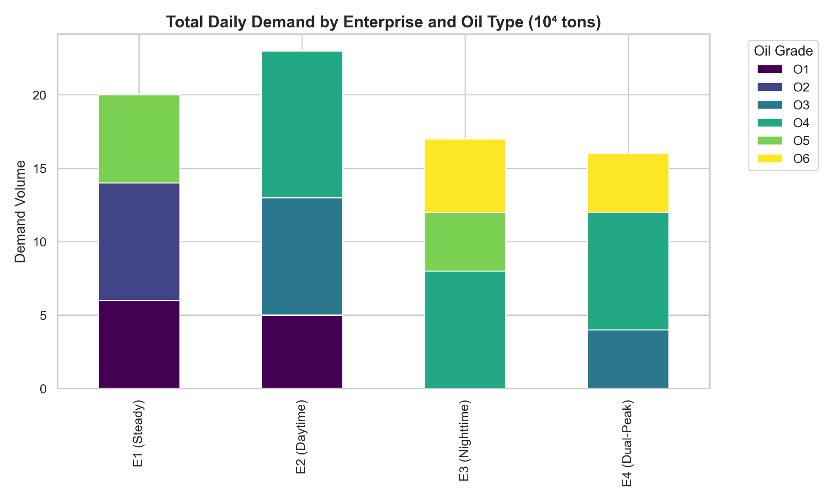
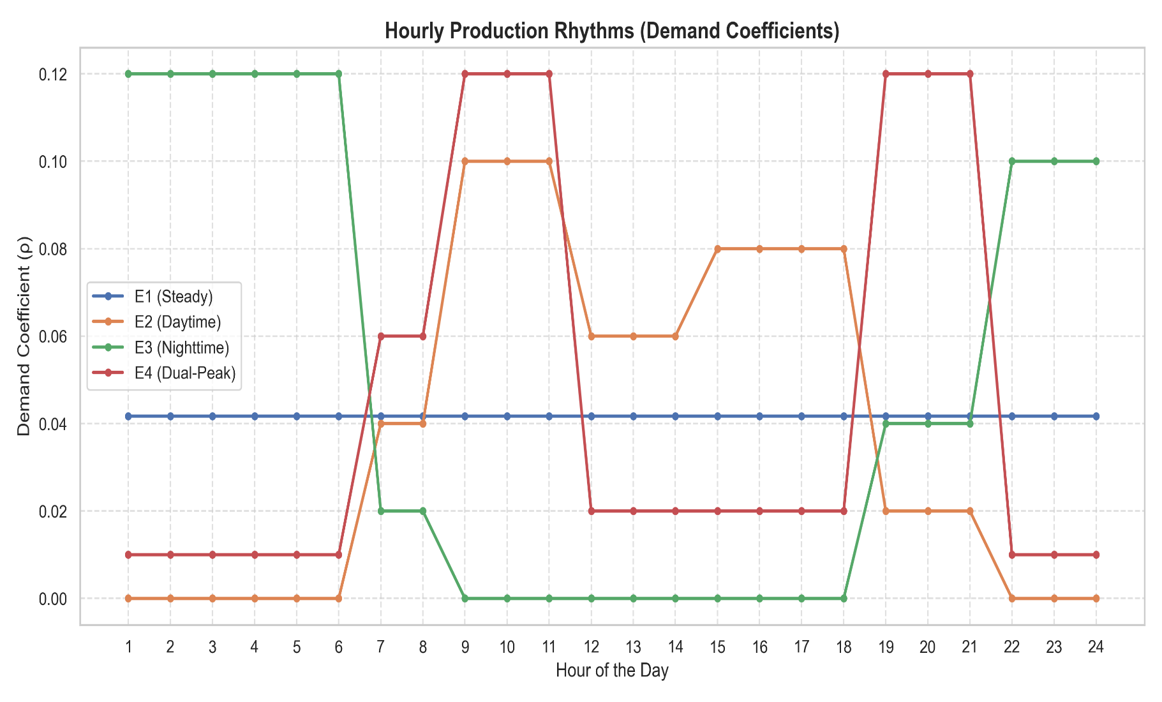
Hourly scheduling requirements
Enterprise Demand Characteristics The logistical challenge is driven by the highly divergent production rhythms of four downstream enterprises. Enterprise E1 operates with a continuous, steady demand of approximately 4.17% per hour. In contrast, the others exhibit significant temporal volatility: E2 concentrates its production during daytime hours (peaking at 10%), E3 focuses on nighttime operations (peaking at 12%), and E4 follows a dual-peak pattern during the morning and evening. Because these enterprises lack local storage capacity, the pipeline network must achieve precise, real-time delivery to meet these fluctuating hourly requirements while navigating the physical constraints of the hub.

Slide 7










The MILP Model
Indices
Constrains
1.Time periods:$\text{T}\text{ = }\text{\{}\text{1,} \text{2}\text{,} …...\text{,} \text{24}\text{\}}$, indexed by t.
2.Storage stations: $\text{S}\text{ = }\text{\{}\text{1,} \text{2,} …...\text{,} \text{6}\text{\}}$, indexed by s.
3.Oil types: $\text{K}\text{ = }\text{\{}\text{1,} \text{2,} …...\text{,} \text{6}\text{\}}$, indexed by k.
4.Enterprises: $\text{Ent}\text{ = }\text{\{}\text{1,} \text{2,} \text{3,} \text{4}\text{\}}$, indexed by j.
5.Pipeline edges: $E = \{(i, j) ∣a pipe exists from node i to j\}\}$, indexed by e.
1.Node Balance and Inventory Dynamics:
$$I_{s,k,t}=I_{s,k,t−1}+\sum_{e∈In\left(s\right)}{x_{e,k,t}}−\sum_{e∈Out\left(s\right)}{x_{e,k,t}}+u_{s,k,t}−d_{s,k,t}, ∀s,k,t$$
2. Demand Satisfaction:
Parameters
$$\sum_{t∈T}{\left(u_{S1,k,t}+u_{S4,k,t}\right)}=DailyNeed_{k}, ∀k∈K$$
1.Distance (Cost coefficient): $Dist_{e}$, the length of pipeline e representing the unit transport cost.
2.Pipeline Capacity: c$ap_{e}$, the maximum total flow allowed through pipeline e per hour.
3.Enterprise Demand: $d_{j,k,t}$, the demand of enterprise j for oil type k at time t.
4.Daily Total Need:$\text{DailyNee}{\text{d}}_{\text{k}}$, the total consumption of oil k across the entire network in 24 hours.
5.Max Unloading Capacity: UnloadMax, the maximum hourly unloading rate at a terminal (S1 or S4).
6.Inventory Bounds: $I_{min}$, $I_{max}$, the minimum and maximum allowable storage levels in the tanks.
3. Pipeline Capacity
$$\sum_{k∈K}{x_{e,k,t}}≤Cap_{e}, ∀e,t$$
4. Mutual Exclusion (Big-M Linearization for Hub S2): For Group A (S2 to S3 vs. S2 to E2):
$$\left\{\begin{matrix} \sum_{k ∈K}{x_{\left(S2 →S3\right),k,t}}≤M ⋅{y_{1,t}}_{ } \\ \sum_{k ∈K}{x_{\left(S2 →E2\right),k,t}}≤M ⋅\left(1 − y_{1.t}\right) \end{matrix}\right\}$$
Objective Function
$$\min{Z}=\sum_{t∈T}{\sum_{k∈K}{\sum_{e∈E}{\left(Dist_{e}⋅x_{e,k,t}\right)}}}+ε⋅\sum_{t∈T}{\sum_{k∈K}{\sum_{m∈\{S1,S4\}}{u_{m,k,t}}}}$$
5.Variable Domains
$$I_{min}≤I_{s,k,t}≤I_{max}$$
$$x_{e,k,t},I_{s,k,t},u_{m,k,t}≥0$$
$$y_{n,t}∈\{0,1\}$$

Slide 8
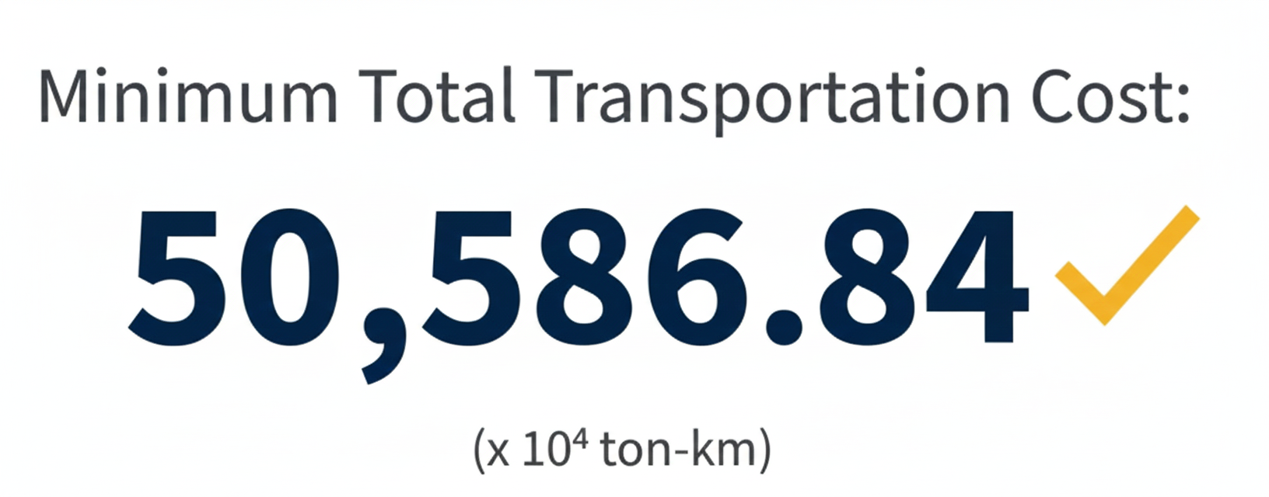
The Optimal Solution
The optimal solution based on the mixed integer linear programming model and the provided dataset, the optimal 24-hour pipeline scheduling solution achieves a total transportation cost of 50,586.84. This solution effectively minimizes overall operational costs while strictly adhering to complex physical and logical constraints, including pipeline flow capacities, station inventory limits, and the mutual exclusion valve switching logic at critical hubs. The comprehensive results are as follows.

Slide 9
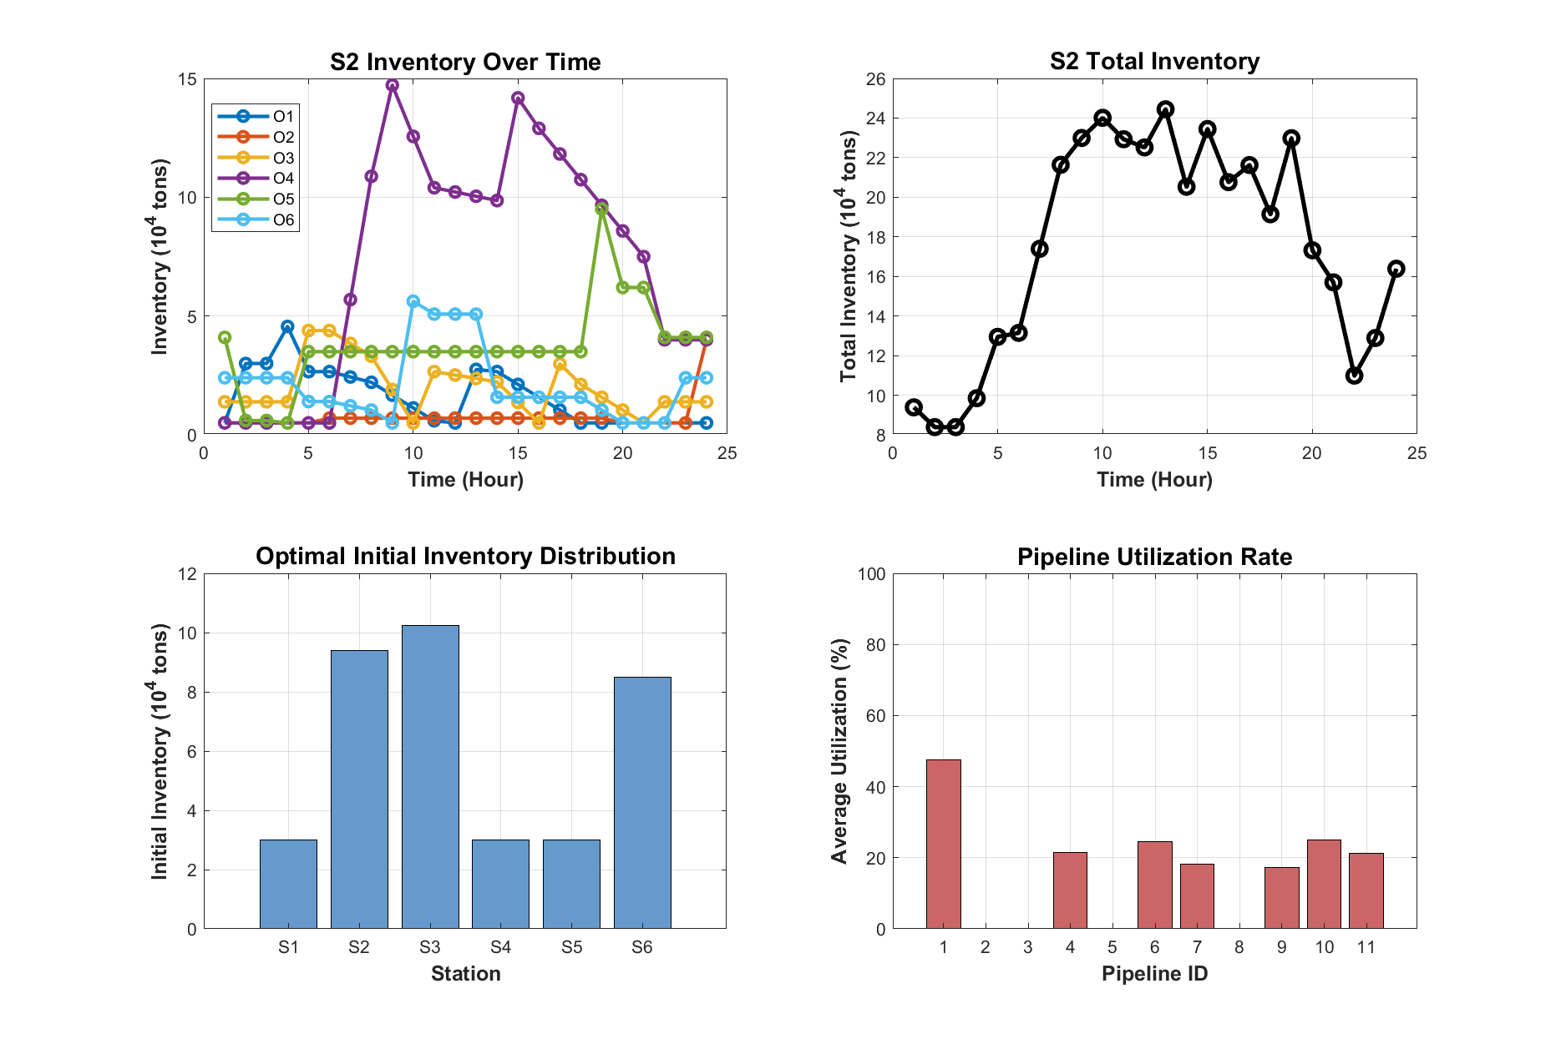
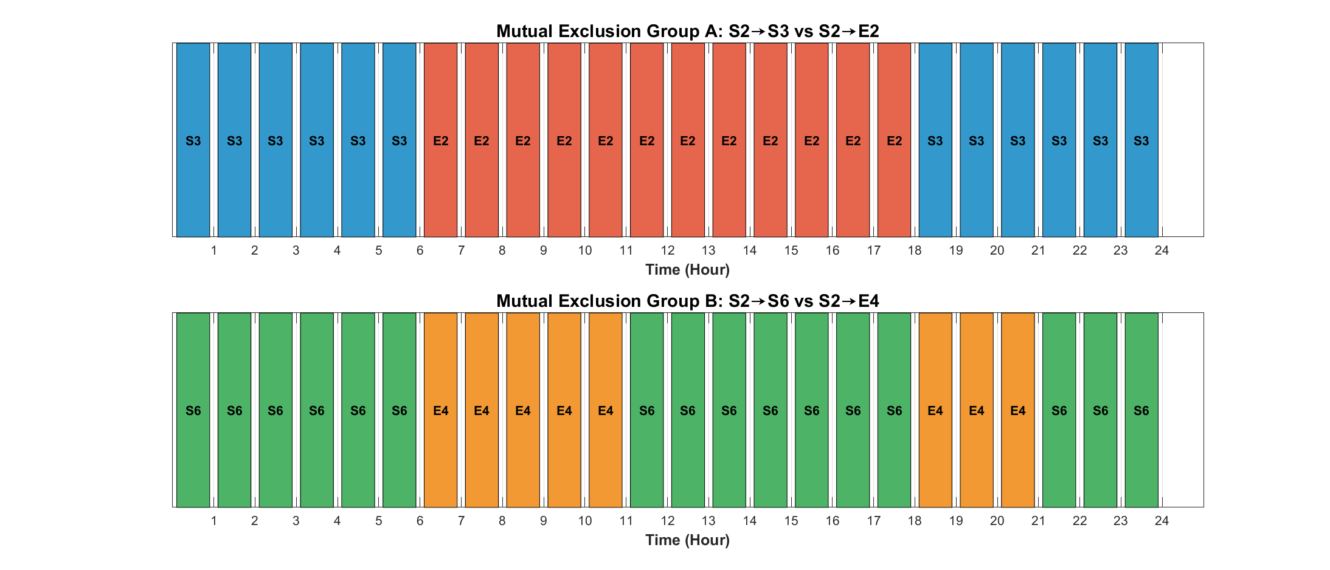
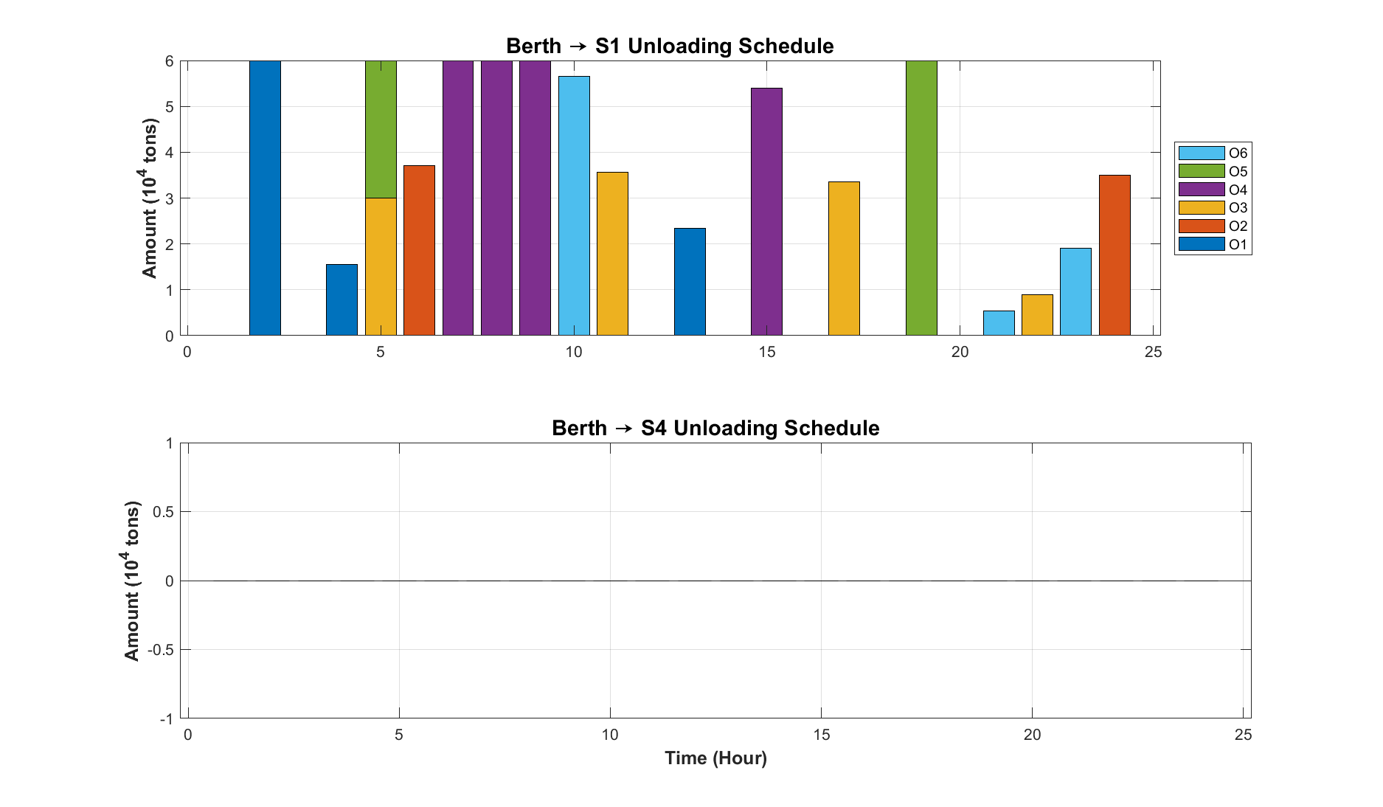
The model identifies an optimal schedule with a minimum transportation cost of 50,586.84(10^4ton-km). Hub Scheduling at S2 functions as a central regulator, with total inventory peaking at ~24 units at Hour 13 to buffer demand, and primary pipelines maintaining a stable ~50% utilization. The Inventory Buffer logic, verified by Gantt charts, prioritizes S3/S6 storage at night and switches to E2/E4 supply during peak windows (Hours 7-11, 19-21) to ensure the I(24)=I(0) steady-state cycle. Finally, Berth Supply Integrity is confirmed as S4 strictly unloads only O3–O6 (zero O1/O2) to satisfy port restrictions, while S1 handles the full O1–O6 spectrum to meet all 12 specific enterprise demands.
Analysis of the Result
Hub Scheduling at S2
Inventory buffer
Sustainable Packaging

Slide 10
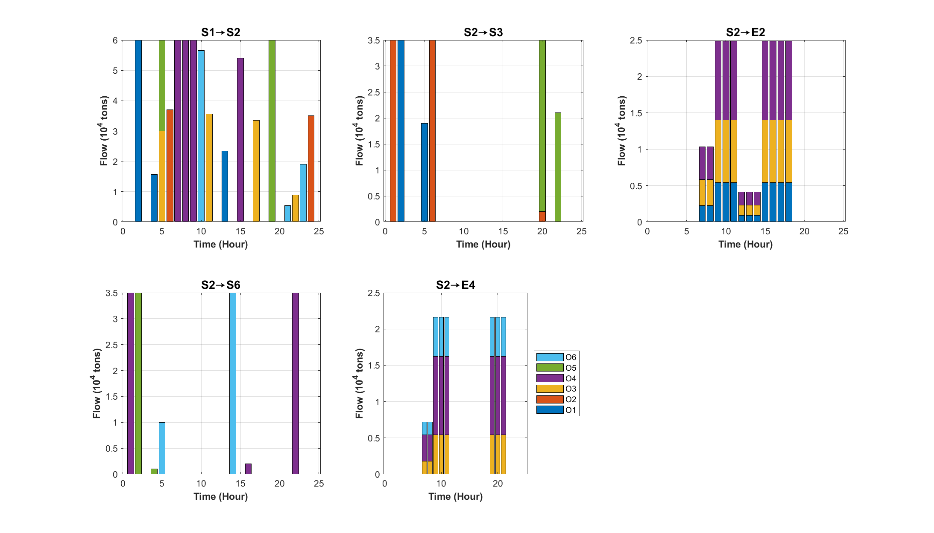
Analysis of the Result
Notes:
关键管道的流量分析

Slide 11
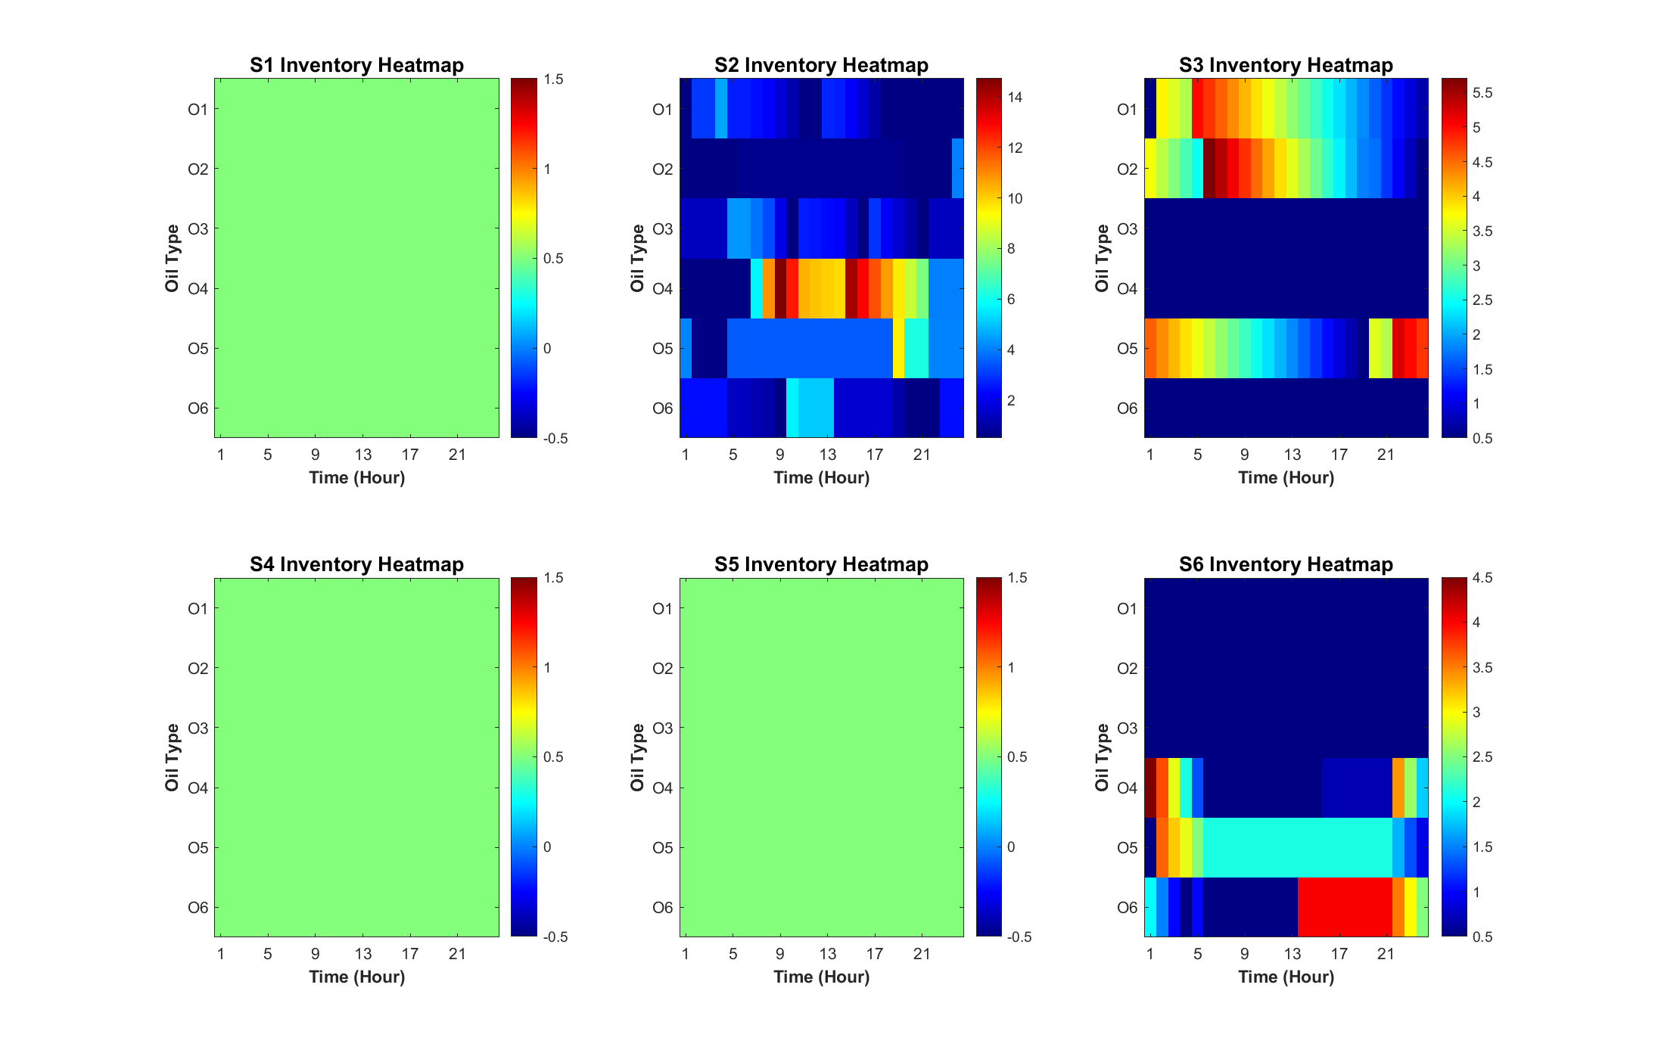
Analysis of the Result
Notes:
各站点存油量随时间变化的热力图

Slide 12
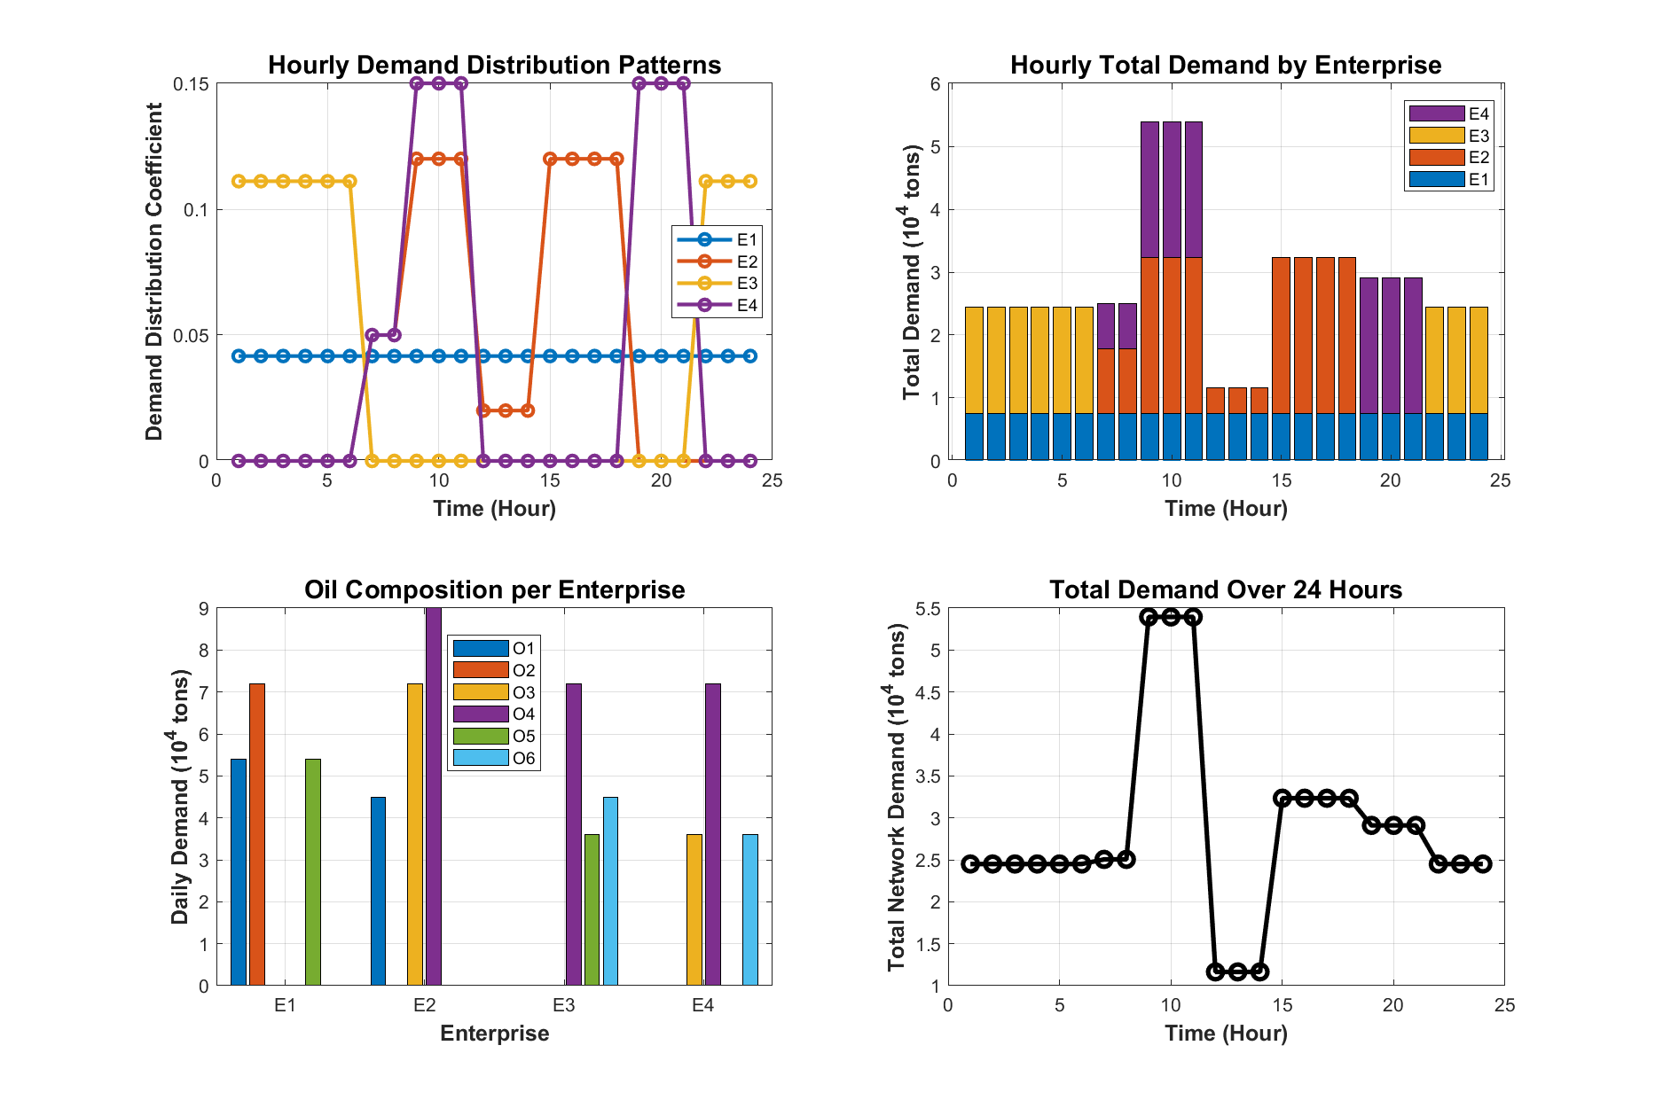
Since S1 possesses the capacity to unload all six crude oil types via its berths, the S1→S2 corridor functions as the network's primary backbone, rendering S4 redundant in the current supply architecture. While the MILP model successfully minimizes total transportation costs, it omits operational penalties for valve switching; the frequent state changes identified at hours 7, 12, 19, and 22 suggest a need for switching frequency penalties to mitigate mechanical wear and pressure surges. Furthermore, as the system is currently optimized for deterministic demand profiles (Steady, Daytime, Nighttime, and Bimodal), future research should integrate stochastic programming to enhance network robustness against unpredictable real-world supply chain fluctuations and consumption spikes.
Limitations
Resource Asymmetry between S1 and S4
Neglect of Switching Penalties at Node S2
Stochastic Demand Resilience

Slide 13


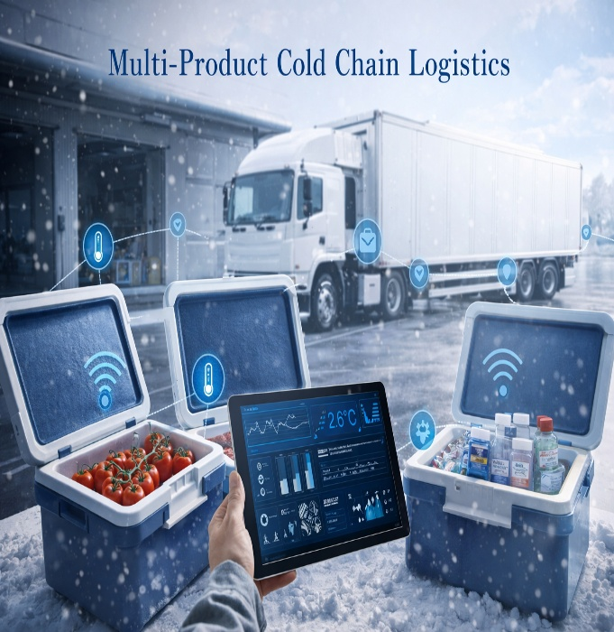


Outlook
The current MILP framework provides a high-precision blueprint for 24-hour cyclic scheduling. Beyond its success in crude oil transportation, this model serves as a scalable decision-making engine with significant potential for refinement and cross-industry application.
Smart Urban Water and Gas Networks
Renewable Energy Storage and Microgrids
Multi-Product Cold Chain Logistics
Automated Manufacturing and Batch Processing
Specialized Port and Container Terminal Operations
The core mutual exclusion logic used at the S2 hub to manage valve states is directly applicable to urban utility grids.
The model’s cyclic steady-state constraint (I(24)=I(0)) is a fundamental requirement for managing energy storage systems, such as large-scale batteries or pumped-hydro storage.
The model's multi-commodity optimization (handling six distinct oil types, O1–O6) can be extended to the logistics of perishable goods with different temperature requirements.
In industrial production, the model can serve as a buffer management tool.
The Berth Supply Integrity logic, which restricts certain docks to specific cargo types (e.g., S4 unloading only O3–O6), is a perfect fit for port management.

Slide 14
Operations Research Course Report
Thank you for listening!
Please feel free to offer your feedback
Xiaoyu Gu, Yiming Zhou, Yunyixuan Zhang
This work was conducted under the supervision of Prof. Wang
January 5, 2025

